Slide 1
Simulation Check of a Nonlinear Focusing Theory for Solenoid Magnets
Hiroshima University AdSM
Beam Physics Lab K.Osaki

Slide 2
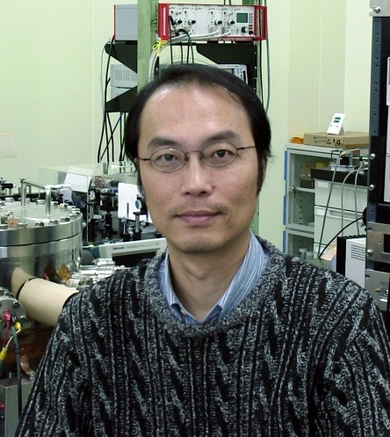

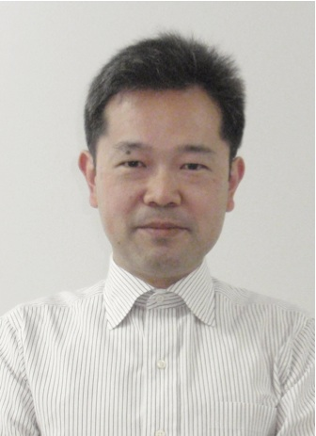
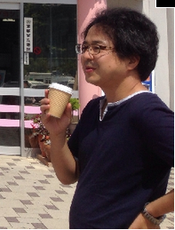
Beam physics research group in Hiroshima University
22 members!!
4 researchers !!
Prof. Hiromi Okamoto
Prof. Masao Kuriki
AP. Hiroyuki Higaki
AP. Kiyokazu Ito

Slide 3
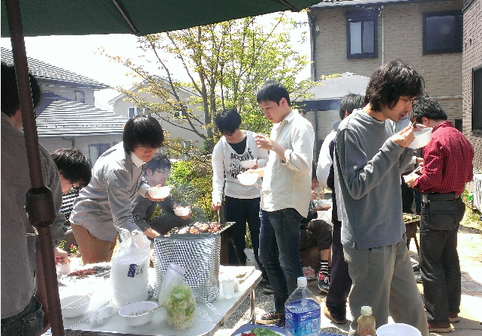

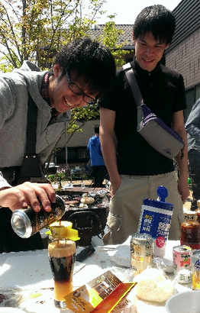
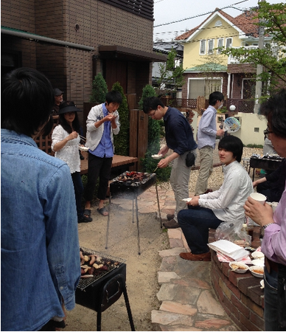

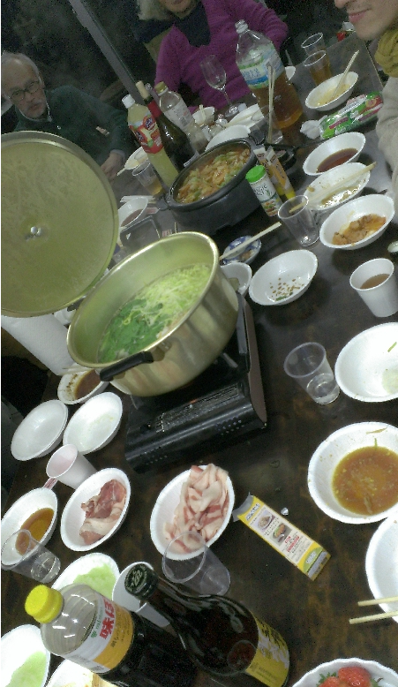
1 postdoctoral researcher, 5 PhD students, 7 master students
and 5 under graduate students !!
BBQ party
A year-end party

Slide 4
About myself
・I’m Kazuya Osaki.
・Third-year PhD student.
・My hobby is Shogi (Japanese chess) and Table tennis !!
・I have been doing my research with analytic work and
numerical simulations.
“Parameter optimization for Doppler laser cooling of a low-energy heavy ion beam
at the storage ring S-LSR”, Prog. Theor. Exp. Phys. 2014, 053G01 K.Osaki and H.Okamoto
“Free-energy formula for emittance growth estimation in intense mismatched beams ”,
Prog. Theor. Exp. Phys. 2015 K.Osaki and H.Okamoto
・I got the position at the accelerator division of laboratory
in Toshiba and start working from April 2016.

Slide 5
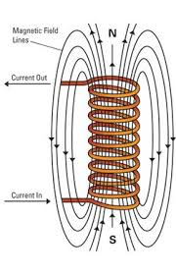
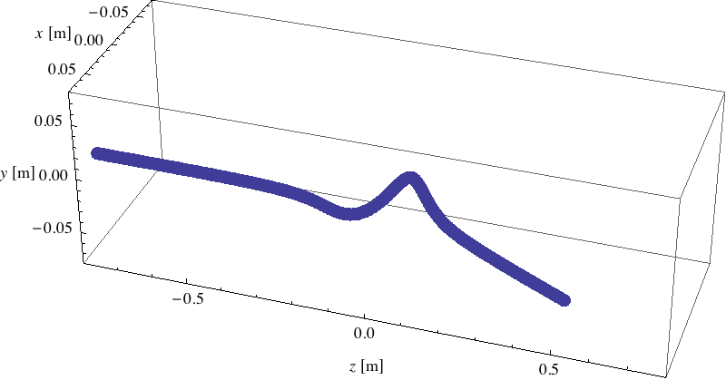
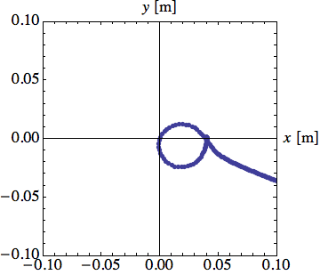
Overview
・The orbit of single particle motion in a solenoid is complicated
because of cross x,y coupling and nonlinearity.
y
z
x
However in spite of nonlinearity an analytic formula has been
derived to describe nonlinear focusing effects.

Slide 6
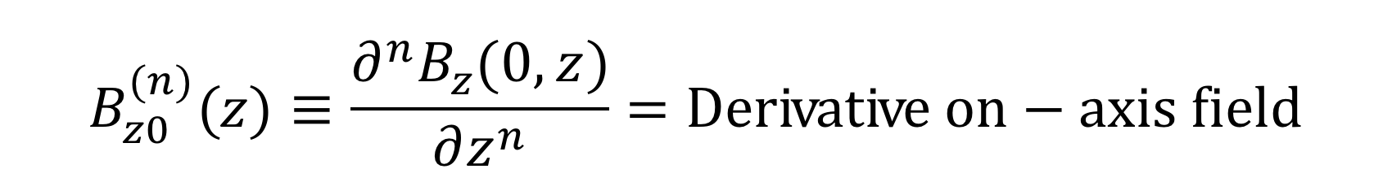
・Prof. Steven Lund derived a simple formula for the nonlinear focusing kick.
・Goal : Check numerically if theory is valid so formula can be reliably
applied to better understand limits of solenoid transport.

Slide 7
Overview of Theory
Theory applies to any axisymmetric solenoid magnet
- Iron
- Iron-free

Slide 8
Conservation Constraints in Solenoid Transport
Kinetic Energy: Magnetic field only bends particle
Canonical Angular Momentum: Invariant with rotations about z-axis
Sometimes called Bush’s Theorem in literature in form applied
Cannot generally take P_{θ} = 0:
Solenoid defines r = 0
General orbit not through origin
For beam not born in B-field <P_{θ}> = 0

Slide 9
Expand solenoid field in terms of on-axis field
9
From the structure of the static Maxwell equations in vacuuo, can expand the axisymmetric field of a solenoid in terms of the on-axis field:

Slide 10
Insert these results in the radial force and acceleration in cylindrical coordinates
Applied Radial Force:
Radial Acceleration:

Slide 11
Employ paraxial approximation to simplify longitudinal dynamics
Paraxial approximation: only significant approximation
Good in most situations except (possibly) near injection energy
But will break radial ordering
at some point
End Result:
Valid to arbitrary radial order (collect terms in radial powers)
Acceleration (dot) version of paraxial formula (prime) is same form and exact
+ Space-Charge term
(not needed for applied
focus properties)

Slide 12
Examine radial accel equation in more detail
Leading order linear optic term clearly expressed
Analysis in rotating “Larmor” frame
Terms proportional to P_{θ} will drop if averaged over a symmetric distribution (i.e. for beam envelope equation)

Slide 13
Structure of low-order radial focus terms (thin coil iron-free solenoid)
Linear
Lowest-Order NonLinear
Next-Order NonLinear
Lowest-Order P_{θ}

Slide 14
Expressing result in terms of angular impulse imparted by magnet clarifies result
Angular Impulse: Measures focal strength of optic
Can be thought of as a nonlinear thin-lens impulse that would be imparted if particle does not change radial coordinate while transiting magnet
Apply to single magnet in isolation
Same formula apply (see summary) to periodic lattice with angular kick per period !
End Result: Much simplified !

Slide 15
Implications of angular kick result
All terms focusing!
All minus sign with positive (squared) integral contribution and P_{θ} terms zero
Expect terms to accumulate in long periodic solenoid channel
Nonlinear defocusing impossible (improved photoinjector matching not possible)
Impossible to remove any nonlinear optic term
Terms can be made larger/smaller by shaping coils/iron but cannot be removed
Any tapering should likely be as gradual as possible else derivative variations become more rapid and likely generate stronger nonlinearity
Likely all you can do is provide magnet designer with as small an aspect ratio (~coil-radius/coil-length) as possible to limit nonlinear terms

Slide 16
Numerical Check of Theory

Slide 17
Purpose of simulations
・Evaluate difference of radial kick between the theory and simulation
to check theory.
Parameters :
Case1 : Take P_{θ} = 0 and change the value of [Bρ] and r_{Init}.
Case2 : Take r_{Init}/R = 0.5 and change the value of [Bρ] and
P_{θ}/βγmc.

Slide 18
Apply Thin Coil Solenoid to Check Theory
・Choose aspect ratio (R/l) typical of short solenoids in machine
front ends of FRIB to get realistic nonlinear fields.
・Nonlinear fields provide good (Analytic) test case for theory that
applies to any solenoid (iron, iron-free)
Ref : Edward Lee and Matthaeus Leitner (LBNL,2007)

Slide 19
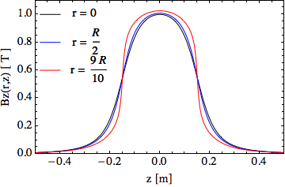
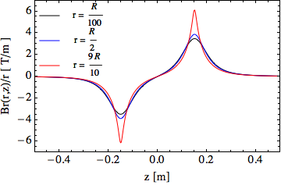
r
8 cm
Initial position
0
z
z = - 10 m
Final position
z = 10 m
R/l=0.267
30 cm
・Typical solenoid aspect ratio (R/L) in front end for realistic nonlinear fields.
・1 Tesla typical field strength. Control coupling by vary [Bρ].
・Difference curves illustrates nonlinear fields. Larger at large r.

Slide 20
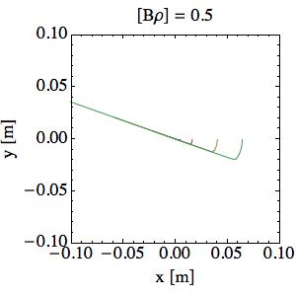
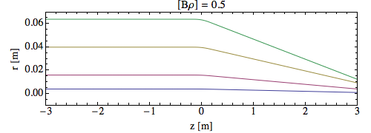
SciPy Integrator
・To numerically calculate single particle orbit, we use a 4th
order Runge-Kutta in SciPy to solve coupled nonlinear ODEs.

Slide 21
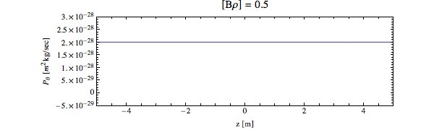
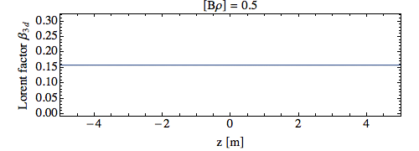
Confirm conserved quantities
Canonical angular momentum P_{θ} = mγ(xv_{y}-yv_{x})+qrA_{θ}
Kinetic energy equivalently β = v/c

Slide 22
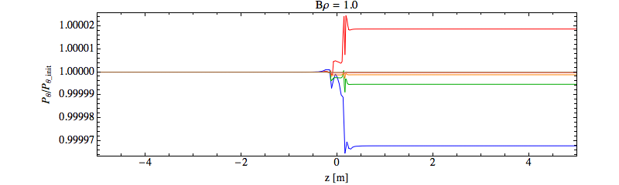
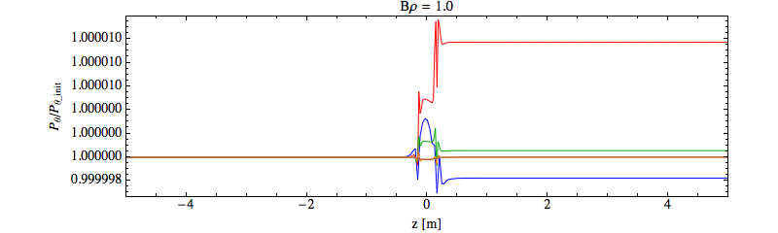
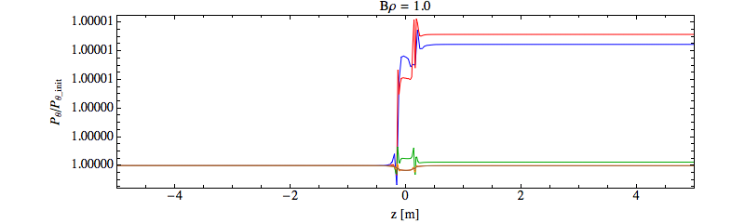
Convergence of P_{θ}
ds=4cm
ds=2cm
ds=1.3cm
ds=1cm
ds=0.8cm
ds=0.67cm
P_{θ}/mc=0.8[mm・mrad]
0.003%
ds=4cm
ds=2cm
ds=1.3cm
ds=1cm
ds=0.8cm
ds=0.67cm
P_{θ}/mc=2.4[mm・mrad]
0.002%
ds=4cm
ds=2cm
ds=1.3cm
ds=1cm
ds=0.8cm
ds=0.67cm
P_{θ}/mc=4.0[mm・mrad]
0.002%
・We should take ds < 1cm, so we took ds = 0.67cm
ds = v_{z}*dt

Slide 23
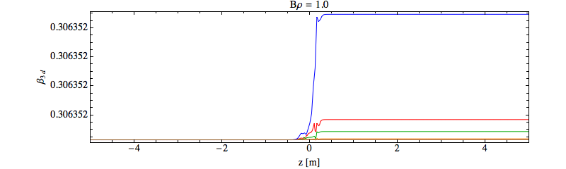
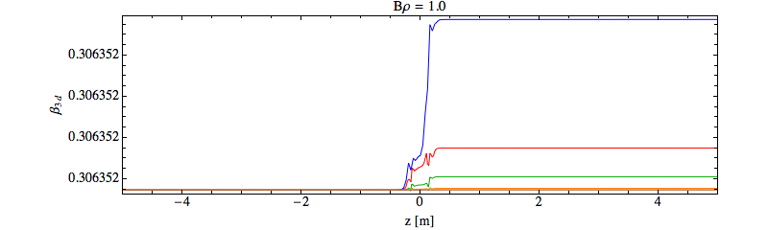
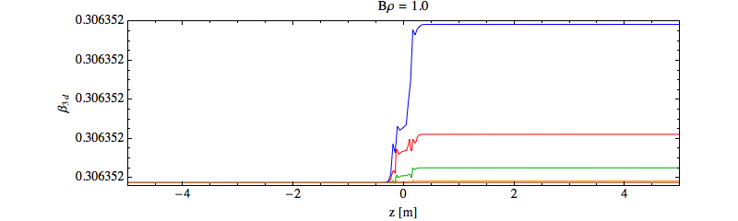
Convergence of Kinetic Energy
ds=4cm
ds=2cm
ds=1.3cm
ds=1cm
ds=0.8cm
ds=0.67cm
3*10⁻⁹%
P_{θ}/mc=0.8[mm・mrad]
ds=4cm
ds=2cm
ds=1.3cm
ds=1cm
ds=0.8cm
ds=0.67cm
3*10⁻⁹%
P_{θ}/mc=2.4[mm・mrad]
ds=4cm
ds=2cm
ds=1.3cm
ds=1cm
ds=0.8cm
ds=0.67cm
P_{θ}/mc=4.0[mm・mrad]
3*10⁻⁹%
・We should take ds < 1cm, so we took ds = 0.67cm
ds = v_{z}*dt

Slide 24
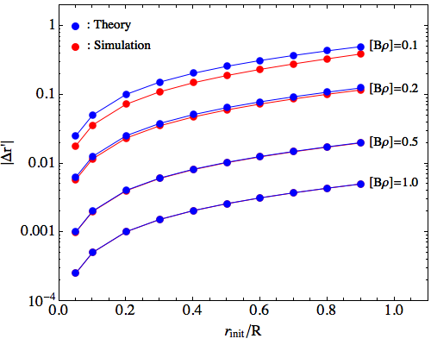
Case1 Check : Comparison between the theory
and simulation for P_{θ}=0 (Change [Bρ] and r_{init})
・Change value of [Bρ] (rigidity) and evaluate difference between
theory and single particle simulations.
・Paraxial approximate thin lens kick formula should break down
when r varies significantly in solenoid.
- [Bρ] small expect break down

Slide 25
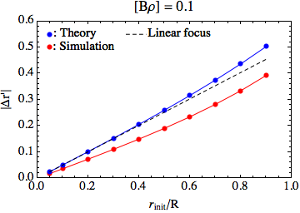
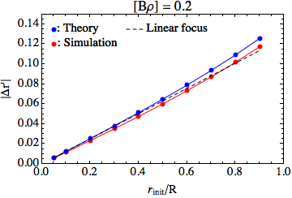
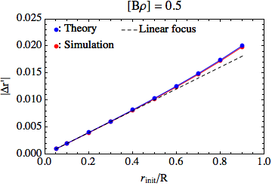
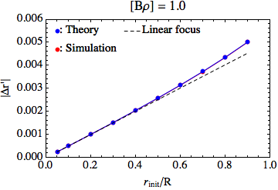
Case1 Check : Linear Plot of Comparison
between the theory and simulation, (R/l = 0.267)

Slide 26
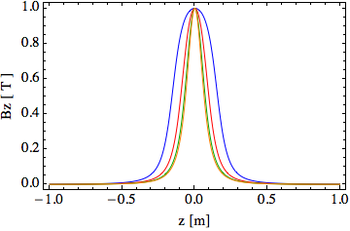
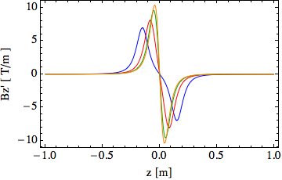
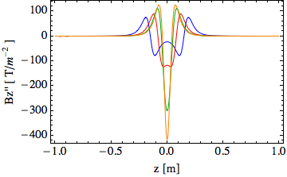
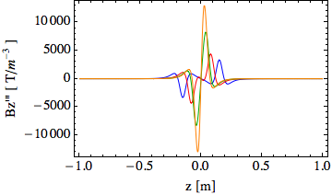
Shorten Aspect Ratio to Enhance Nonlinear Fields
R = 8 cm (fix)
R/l = 0.267
Base (Typical front end)
l = 30 cm (shorten)
R/l=0.267
R/l=0.267
R/l=0.5
R/l=0.5
R/l=1.0
R/l=1.0
R/l=2.0
R/l=2.0
R/l=0.267
R/l=0.5
R/l=1.0
R/l=0.267
R/l=2.0
R/l=0.5
R/l=1.0
R/l=2.0

Slide 27
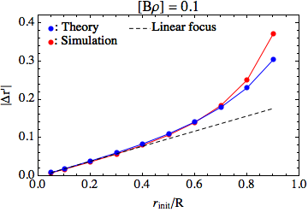
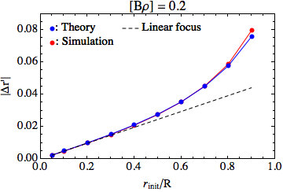
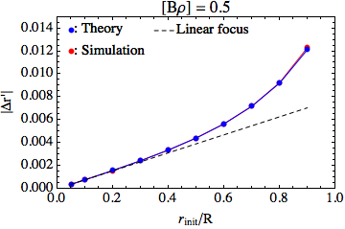
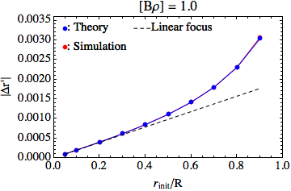
Theory description of nonlinear focus effects
works well for very short solenoid ( R/l = 2 )

Slide 28
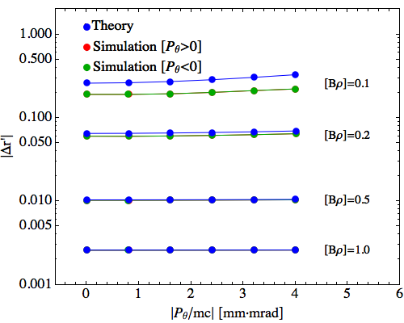
Case2 Check : Comparison between the theory
and simulation for P_{θ}≠0 (Fix r_{Init}/R=0.5,R/l=0.267)
・Difference again small when [Bρ] large.
・Results same for ± P_{θ} as expected.
Previous case P_{θ}=0
Large Centrifugal Defocusing

Slide 29
Case2 Check : Comparison between the theory
and simulation for P_{θ}≠0 (Fix r_{Init}/R=0.5,R/l=2)
・Difference again small when [Bρ] large.
・Results same for ± P_{θ} as expected.
Previous case P_{θ}=0
Large Centrifugal Defocusing

Slide 30
Case1 : P_{θ}=0
Looking at amplitude and [Bρ] variation.
Numerical verified Theory.
Case2 : P_{θ}≠0
What scale P_{θ} to use ?

Slide 31
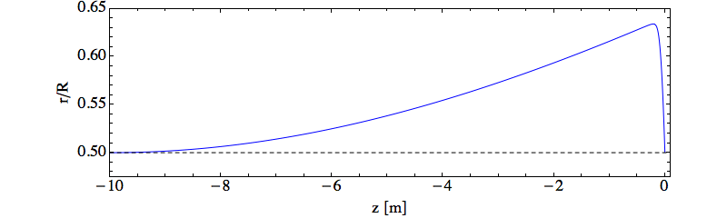

Find “large” value of P_{θ}/βγmc
Centrifugal Defocusing
Solenoid Focusing
・Solve radial equation numerically with initial condition.
Launch
Center Magnet
・Find value of P_{θ}/βγmc such that.
- Centrifugal defocusing balances Solenoid
focusing to find large scale of P_{θ.}
We employ this value of P_{θ}/βγmc to set the upper range to explore

Slide 32
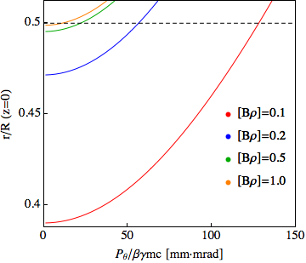
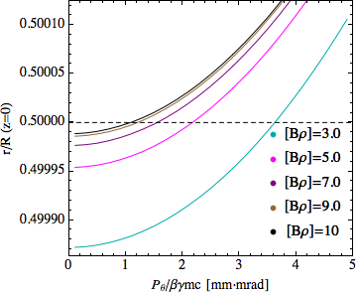
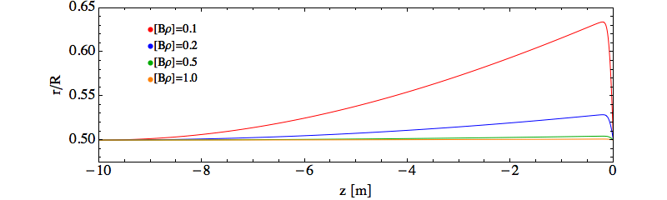
Results of numerical solutions for P_{θ} scale
Bρ = 0.1 ~ 10, Energy = 0.48MeV ~ 2.2GeV (Proton)
Centrifugal Defocus
Balance solenoid focus
Launch
Center Magnet

Slide 33
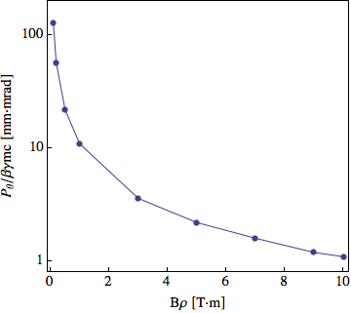
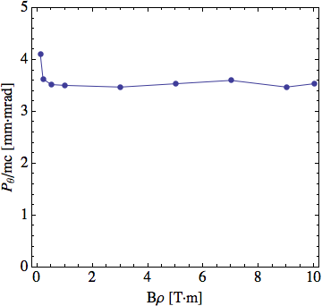
Summary of numerical solutions for P_{θ} scale
・Large value of P_{θ}/βγmc as function of [Bρ].
“Unnormalized”
“Normalized”
・Normalized P_{θ}/mc has similar large values for all [Bρ].

Slide 34
Canonical angular momentum of beam enters rms envelope
equation in terms of an emittance-like defocusing term.
Envelope equation for coasting axisymmetric beam without space-charge
Applied Focus
Emittance Defocus
For beam with canonical angular momentum
Therefore,

Slide 35
Normalized emittance of several accelerators
around the world
In the case of proton accelerator
Accelerator | Particle | Norm emittance
J-PARC | Proton | 4 mm.mrad
KEK-PS | Proton | 10 mm.mrad
CERN-PS | Proton | 10 mm.mrad
TEVATRON | Proton | 20 mm.mrad
SPS | Proton | 3.5 mm.mrad
FRIB | Uranium | 0.5 mm.mrad
Taking P_{θ}/mc = 4 mm・mrad for a large single particle value looks
surprisingly consistent with many “emittance” defocused beams

Slide 36
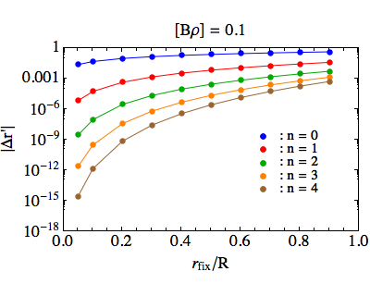
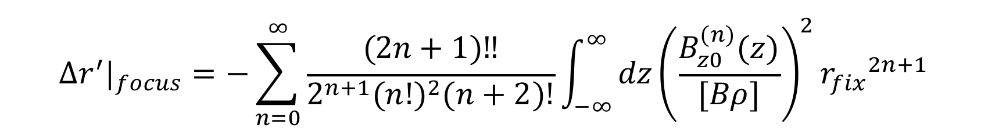
Check magnitude of theoretical radial kick
in each order through thin coil nonlinear solenoid
・Cut off n=5 should be
acceptable for all cases.

Slide 37
Conclusions
・Theoretical formula works well except where radius
changes a lot ([Bρ] small).
- Will submit for publication
- Can now confidently apply in next steps
・Future work :
Use formula to derive a theory of emittance growth from applied field nonlinearity to guide choice of solenoid parameters in lab.
・Goal :
Provide users acceptable aspect ratio solenoids with no simulations needed, for typical iron-free and iron solenoid designs.

Slide 38
Extra Slides

Slide 39
Initial Proton condition of simulations (Case1)
Main parameters
Initial position of x | 0.05*R ~ 0.9*R
Initial position of y | 0
Initial position of z | -10 m
Initial velocity of x | 0
Initial velocity of y | 0
Initial velocity of z | 3.22*10⁻²*c ~ 0.955*c
Final position of z | 10 m
P_{θ} | 0
Number of simulation step | 3000
Bρ | 0.1 to 10
Solenoid length | 30 cm
Solenoid radius | 8 cm
Center of magnetic field | 1Tesla
- We apply the magnetic fields of thin coil solenoid given from Maxwell equation.
- After finish single particle simulations, calculate several physical quantities.

Slide 40
Initial Proton condition of simulations (Case2)
Main parameters
Initial position of x | 0.5*R
Initial position of y | 0
Initial position of z | -10 m
Initial velocity of x | 0
Initial velocity of y | 2P_{θ}/mγR
Initial velocity of z | 3.22*10⁻²*c ~ 0.955*c
Final position of z | 10 m
P_{θ} | 0 ~ mc*4*10⁻⁶
Number of simulation step | 3000
Bρ | 0.1 to 10
Solenoid length | 30 cm
Solenoid radius | 8 cm
Center of magnetic field | 1Tesla
- We apply the magnetic fields of thin coil solenoid given from Maxwell equation.
- After finish single particle simulations, calculate several physical quantities from the orbit.

Slide 41
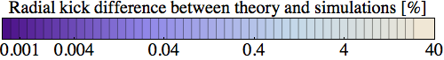
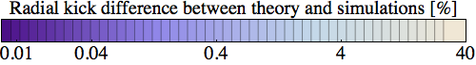
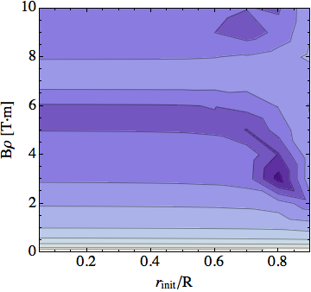
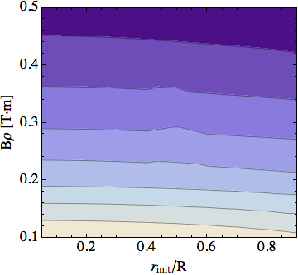
Contour plot of difference between theory and simulations
・As [Bρ] increase, the difference between theory and simulations
become small.

Slide 42
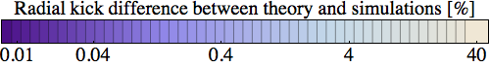



Contour plot of difference between theory and simulation
・As [Bρ] increases, the difference between theory and
simulations become small.

Slide 43




Case1 Check : Linear Plot of Comparison
between the theory and simulation ( R/l = 1 )

Slide 44




Case1 Check : Linear Plot of Comparison
between the theory and simulation ( R/l = 0.5 )

